Slide 1
Temporal Probabilistic Models Pt 2

Slide 2
Agenda
Kalman filtering
Dynamic Bayesian Networks
Particle filtering

Slide 3
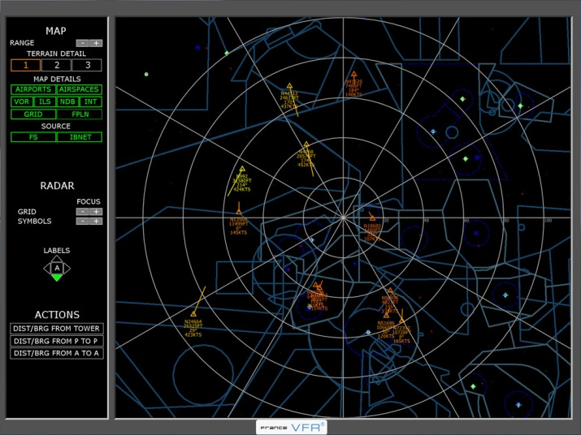
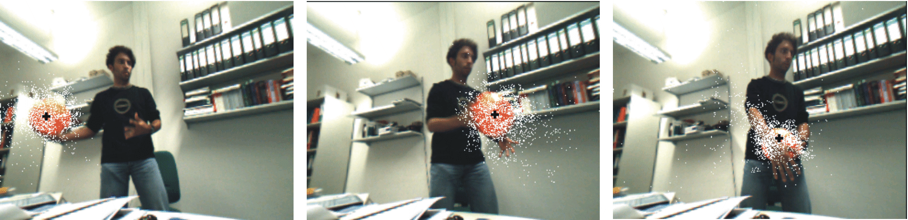
Kalman Filtering
In a nutshell
Efficient filtering in continuous state spaces
Gaussian transition and observation models
Ubiquitous for tracking with noisy sensors, e.g. radar, GPS, cameras

Slide 4
Hidden Markov Model for Robot Localization
Use observations + transition dynamics to get a better idea of where the robot is at time t
X₀
X₁
X₂
X₃
Hidden state variables
z₁
z₂
z₃
Observed variables
Predict – observe – predict – observe…

Slide 5
Hidden Markov Model for Robot Localization
Use observations + transition dynamics to get a better idea of where the robot is at time t
Maintain a belief state b_{t} over time
b_{t}(x) = P(X_{t}=x|z_{1:t})
X₀
X₁
X₂
X₃
Hidden state variables
z₁
z₂
z₃
Observed variables
Predict – observe – predict – observe…

Slide 6

Bayesian Filtering with Belief States
Compute b_{t}, given z_{t} and prior belief b_{t}
Recursive filtering equation
$P\left(x_{t} | z_{1:t}\right)=\sum_{x_{t−1}}{P\left(x_{t} | x_{t−1},z_{1:t}\right)P(x_{t−1}|z_{1:t−1})}$
$=\frac{1}{Z}P\left(z_{t} | x_{t}\right)\sum_{x_{t−1}}{P\left(x_{t} | x_{t−1}\right)P(x_{t−1}|z_{1:t−1})}$

Slide 7
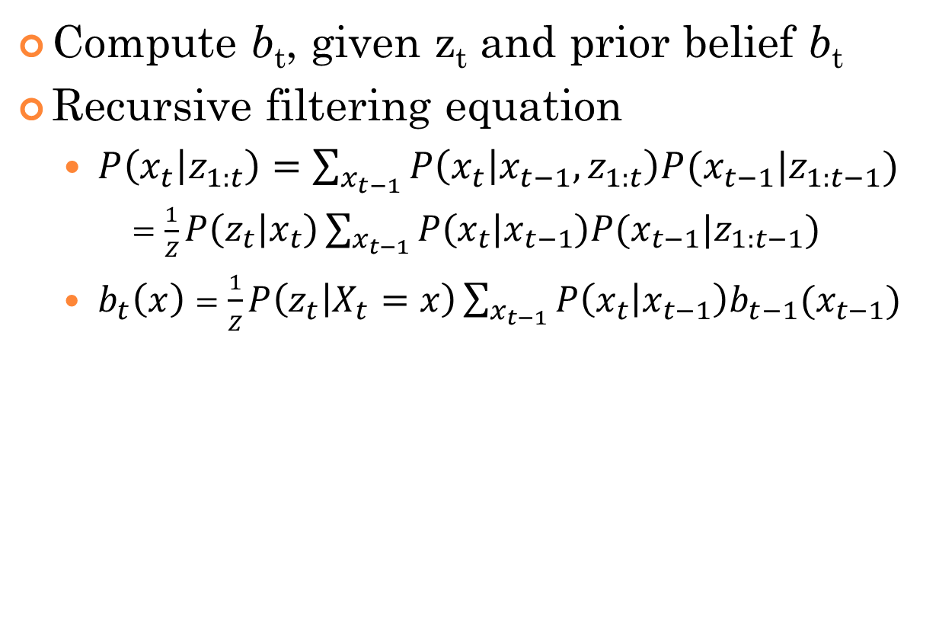
Bayesian Filtering with Belief States
Compute b_{t}, given z_{t} and prior belief b_{t}
Recursive filtering equation
$P\left(x_{t} | z_{1:t}\right)=\sum_{x_{t−1}}{P\left(x_{t} | x_{t−1},z_{1:t}\right)P(x_{t−1}|z_{1:t−1})}$
$=\frac{1}{Z}P\left(z_{t} | x_{t}\right)\sum_{x_{t−1}}{P\left(x_{t} | x_{t−1}\right)P(x_{t−1}|z_{1:t−1})}$
$b_{t}\left(x\right)=\frac{1}{Z}P\left(z_{t} | X_{t}=x\right)\sum_{x_{t−1}}{P\left(x_{t} | x_{t−1}\right)b_{t−1}(x_{t−1})}$
Update via the observation z_{t}
Predict P(X_{t}|z_{1:t-1}) using dynamics alone

Slide 8

In Continuous State Spaces…
Compute b_{t}, given z_{t} and prior belief b_{t}
Continuous filtering equation
$b_{t}\left(x\right)=\frac{1}{Z}P\left(z_{t} | X_{t}=x\right)\int_{x_{t−1}}{P\left(x_{t} | x_{t−1}\right)b_{t−1}(x_{t−1})}dx_{t−1}$

Slide 9
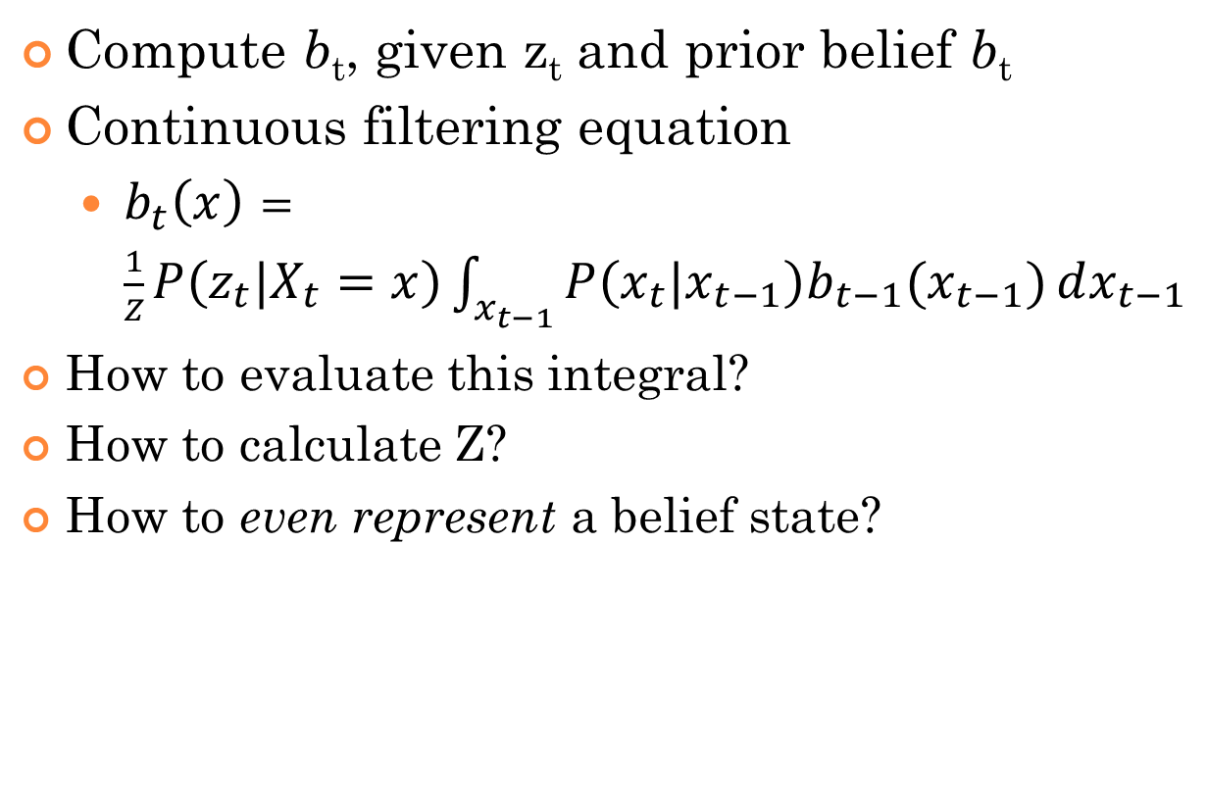
General Bayesian Filtering in Continuous State Spaces
Compute b_{t}, given z_{t} and prior belief b_{t}
Continuous filtering equation
$b_{t}\left(x\right)=\frac{1}{Z}P\left(z_{t} | X_{t}=x\right)\int_{x_{t−1}}{P\left(x_{t} | x_{t−1}\right)b_{t−1}(x_{t−1})}dx_{t−1}$
How to evaluate this integral?
How to calculate Z?
How to even represent a belief state?

Slide 10
Key Representational Decisions
Pick a method for representing distributions
Discrete: tables
Continuous: fixed parameterized classes vs. particle-based techniques
Devise methods to perform key calculations (marginalization, conditioning) on the representation
Exact or approximate?

Slide 11
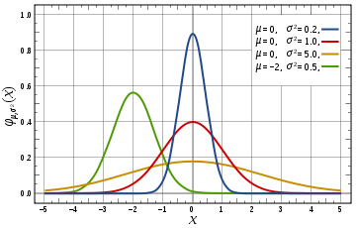
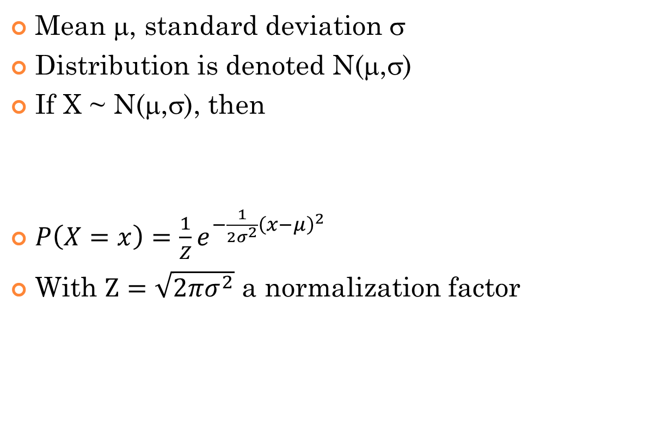
Gaussian Distribution
Mean μ, standard deviation σ
Distribution is denoted N(μ,σ)
If X ~ N(μ,σ), then
$P\left(X=x\right)=\frac{1}{Z}e^{−\frac{1}{2σ^{2}}{\left(x−μ\right)}^{2}}$
With $Z=\sqrt{2πσ^{2}}$ a normalization factor

Slide 12
Linear Gaussian Transition Model for Moving 1D Point
Consider position and velocity x_{t}, v_{t}
Time step h
Without noise x_{t+1} = x_{t} + h v_{t} v_{t+1} = v_{t}
With Gaussian noise of std σ₁
P(x_{t+1}|x_{t}) ∝ exp(-(x_{t+1} – (x_{t} + h v_{t}))²/(2σ₁²)
i.e. X_{t+1} ~ N(x_{t} + h v_{t}, σ₁)

Slide 13
Linear Gaussian Transition Model
If prior on position is Gaussian, then the posterior is also Gaussian
vh
σ₁
N(μ,σ) → N(μ+vh,σ+σ₁)

Slide 14
Linear Gaussian Observation Model
Position observation z_{t}
Gaussian noise of std σ₂
z_{t} ~ N(x_{t},σ₂)

Slide 15
Linear Gaussian Observation Model
If prior on position is Gaussian, then the posterior is also Gaussian
Posterior probability
Observation probability
Position prior
→ (σ²z+σ₂²μ)/(σ²+σ₂²)
σ² → σ²σ₂²/(σ²+σ₂²)

Slide 16
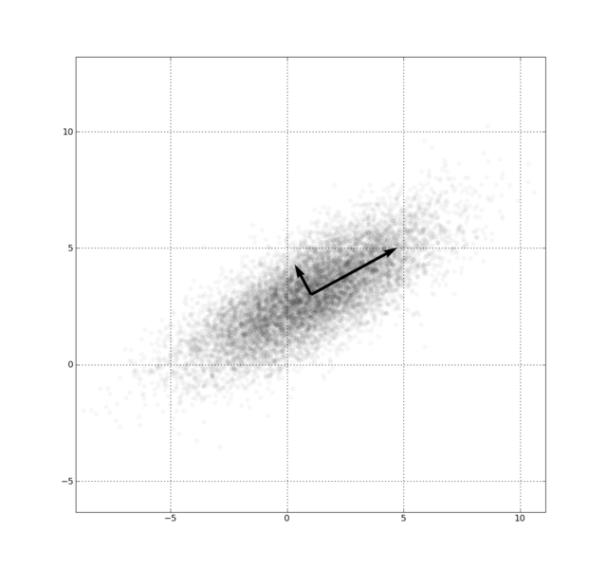

Multivariate Gaussians
X ~ N(μ,Σ)
Multivariate analog in N-D space
Mean (vector) μ, covariance (matrix) Σ
$P\left(X=x\right)=\frac{1}{Z}e^{−\frac{1}{2}{\left(x−μ\right)}^{T}Σ^{−1}\left(x−μ\right)}$
With $Z={(2π)}^{d/2}{\left|Σ\right|}^{1/2}$ a normalization factor

Slide 17
Multivariate Linear Gaussian Process
A linear transformation + multivariate Gaussian noise
If prior state distribution is Gaussian, then posterior state distribution is Gaussian
If we observe one component of a Gaussian, then its posterior is also Gaussian
y = A x + ε
ε ~ N(μ,Σ)

Slide 18
Multivariate Computations
Linear transformations of gaussians
If x ~ N(μ,Σ), y = A x + b
Then y ~ N(Aμ+b, AΣA^{T})
Consequence
If x ~ N(μ_{x},Σ_{x}), y ~ N(μ_{y},Σ_{y}), z=x+y
Then z ~ N(μ_{x}+μ_{y},Σ_{x}+Σ_{y})
Conditional of gaussian
If [x₁,x₂] ~ N([μ₁ μ₂],[Σ₁₁,Σ₁₂;Σ₂₁,Σ₂₂])
Then on observing x₂=z, we have x₁ ~ N(μ₁-Σ₁₂Σ₂₂⁻¹(z-μ₂), Σ₁₁-Σ₁₂Σ₂₂⁻¹Σ₂₁)

Slide 19
Kalman Filter Assumptions
x_{t} ~ N(μ_{x},Σ_{x})
x_{t+1} = F x_{t} + g + v
z_{t+1} = H x_{t+1} + w
v ~ N(0,Σ_{v}), w ~ N(0,Σ_{w})
Dynamics noise
Observation noise

Slide 20
Two Steps
Maintain μ_{t}, Σ_{t} the parameters of the gaussian distribution over state x_{t}
Predict
Compute distribution of x_{t+1} using dynamics model alone
Update (observe z_{t+1})
Compute P(x_{t+1}|z_{t+1}) with Bayes rule

Slide 21
Two Steps
Maintain μ_{t}, Σ_{t} the parameters of the gaussian distribution over state x_{t}
Predict
Compute distribution of x_{t+1} using dynamics model alone
x_{t+1} ~ N(Fμ_{t} + g, F Σ_{t} F^{T} + Σ_{v})
Let these be N(μ’,Σ’)
Update
Compute P(x_{t+1}|z_{t+1}) with Bayes rule

Slide 22
Two Steps
Maintain μ_{t}, Σ_{t} the parameters of the gaussian distribution over state x_{t}
Predict
Compute distribution of x_{t+1} using dynamics model alone
x_{t+1} ~ N(Fμ_{t} + g, F Σ_{t} F^{T} + Σ_{v})
Let these be N(μ’,Σ’)
Update
Compute P(x_{t+1}|z_{t+1}) with Bayes rule
Parameters of final distribution μ_{t+1} and Σ_{t+1} derived using the conditional distribution formulas

Slide 23
Deriving the Update Rule
x_{t}
z_{t}
μ’
a
Σ’ B
B^{T} C
(1) Unknowns a,B,C
= N ( , )
x_{t} ~ N(μ’ , Σ’)
(2) Assumption
z_{t} | x_{t} ~ N(H x_{t}, Σ_{W})
(3) Assumption
z_{t} | x_{t} ~ N(a-B^{T}Σ’⁻¹x_{t}, C-B^{T}Σ’⁻¹B)
(4) Conditioning (1)
H x_{t} = a-B^{T}Σ’⁻¹(x_{t}-μ’) => a=Hμ’, B^{T}=HΣ’
(5) Set mean (4)=(3)
C-B^{T}Σ’⁻¹B = Σ_{W} => C = H Σ’ H^{T} + Σ_{W}
(6) Set cov. (4)=(3)
x_{t} | z_{t} ~ N(μ’-BC⁻¹(z_{t}-a), Σ’-BC⁻¹B^{T})
(7) Conditioning (1)
μ_{t} = μ’ - Σ’H^{T}C⁻¹(z_{t}-Hμ’)
(8,9) Kalman filter
Σ_{t} = Σ’ - Σ’H^{T}C⁻¹HΣ’

Slide 24
Putting it together
Transition matrix F, covariance Σ_{x}
Observation matrix H, covariance Σ_{z} μ_{t+1} = F μ_{t} + K_{t+1}(z_{t+1} – HFμ_{t}) Σ_{t+1} = (I - K_{t+1})(FΣ_{t}F^{T} + Σ_{x}) Where K_{t+1}= (FΣ_{t}F^{T} + Σ_{x})H^{T}(H(FΣ_{t}F^{T} + Σ_{x})H^{T} +Σ_{z})⁻¹
Got that memorized?

Slide 25
Properties of Kalman Filter
Optimal Bayesian estimate for linear Gaussian transition/observation models
Need estimates of covariance… model identification necessary
Extensions to nonlinear transition/observation models work as long as they aren’t too nonlinear
Extended Kalman Filter
Unscented Kalman Filter

Slide 26
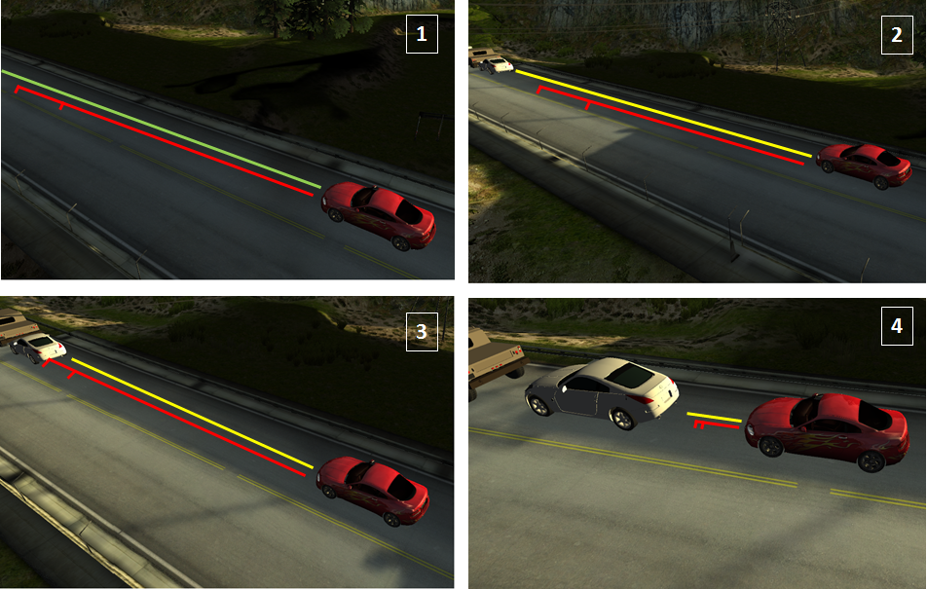
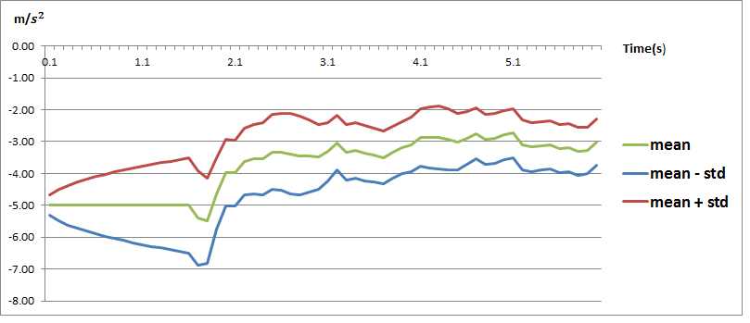
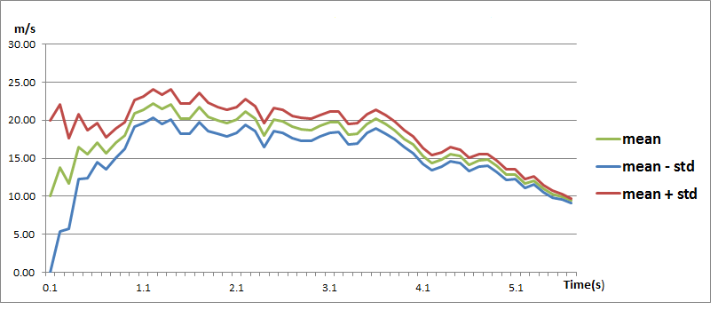
Stopping distance (95% confidence interval)
Braking initiated
Gradual stop
Braking begins
Actual max deceleration
More distance measurements arrive
Obstacle slows
Estimated max deceleration
Velocity initially uninformed
Learning that the road is slick
Tracking the velocity of a braking obstacle

Slide 27

Non-Gaussian distributions
Gaussian distributions are a “lump”
Kalman filter estimate

Slide 28
Non-Gaussian distributions
Integrating continuous and discrete states
“up”
“down”
Splitting with a binary choice

Slide 29
Example: Failure detection
Consider a battery meter sensor
Battery = true level of battery
BMeter = sensor reading
Transient failures: send garbage at time t
Persistent failures: send garbage forever

Slide 30
Example: Failure detection
Consider a battery meter sensor
Battery = true level of battery
BMeter = sensor reading
Transient failures: send garbage at time t
5555500555…
Persistent failures: sensor is broken
5555500000…

Slide 31
Dynamic Bayesian Network
(Think of this structure “unrolled” forever…)
Battery_{t-1}
Battery_{t}
BMeter_{t}
BMeter_{t} ~ N(Battery_{t},σ)

Slide 32
Dynamic Bayesian Network
Battery_{t-1}
Battery_{t}
BMeter_{t}
BMeter_{t} ~ N(Battery_{t},σ)
Transient failure model
P(BMeter_{t}=0 | Battery_{t}=5) = 0.03

Slide 33
Results on Transient Failure
Meter reads 55555005555…
Transient failure occurs
With model
E(Battery_{t})
Without model

Slide 34
Results on Persistent Failure
Meter reads 5555500000…
Persistent failure occurs
E(Battery_{t})
With transient model

Slide 35
Persistent Failure Model
Example of a Dynamic Bayesian Network (DBN)
Broken_{t-1}
Broken_{t}
Battery_{t-1}
Battery_{t}
BMeter_{t}
BMeter_{t} ~ N(Battery_{t},σ)
P(BMeter_{t}=0 | Battery_{t}=5) = 0.03
P(BMeter_{t}=0 | Broken_{t}) = 1

Slide 36
Results on Persistent Failure
Meter reads 5555500000…
Persistent failure occurs
With persistent failure model
E(Battery_{t})
With transient model

Slide 37
How to perform inference on DBN?
Exact inference on “unrolled” BN
Variable Elimination – eliminate old time steps
After a few time steps, all variables in the state space become dependent!
Lost sparsity structure
Approximate inference
Particle Filtering

Slide 38
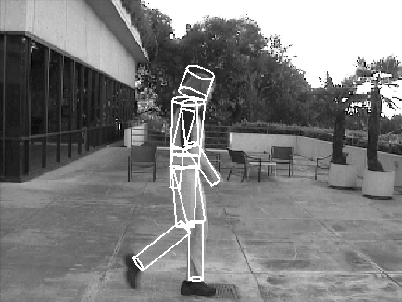
Particle Filtering (aka Sequential Monte Carlo)
Represent distributions as a set of particles
Applicable to non-gaussian high-D distributions
Convenient implementations
Widely used in vision, robotics

Slide 39
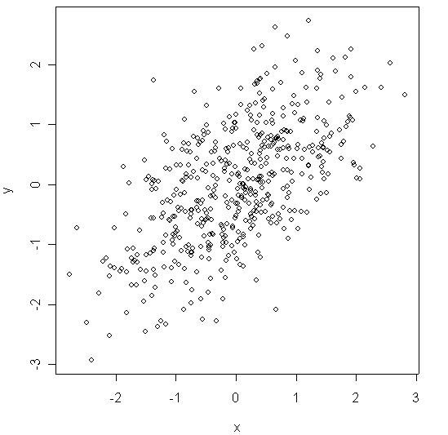
Particle Representation
Bel(x_{t}) = {(w^{k},x^{k})}
w^{k} are weights, x^{k} are state hypotheses
Weights sum to 1
Approximates the underlying distribution

Slide 40
Particle Filtering
Represent a distribution at time t as a set of N “particles” S_{t}¹,…,S_{t}^{N}
Repeat for t=0,1,2,…
Sample S[i] from P(X_{t+1}|X_{t}=S_{t}^{i}) for all i
Compute weight w[i] = P(e|X_{t+1}=S[i]) for all i
Sample S_{t+1}^{i} from S[.] according to weights w[.]
Weighted resampling step

Slide 41
Battery Example
Sampling step
Broken_{t-1}
Broken_{t}
Battery_{t-1}
Battery_{t}
BMeter_{t}

Slide 42
Battery Example
P(BMeter=0|sample) = ?
Broken_{t-1}
Broken_{t}
0.03
1
Battery_{t-1}
Battery_{t}
BMeter_{t}
Suppose we now observe BMeter=0

Slide 43
Battery Example
P(BMeter=0|sample) = ?
Broken_{t-1}
Broken_{t}
0.03
1
Battery_{t-1}
Battery_{t}
BMeter_{t}
Compute weights (drawn as particle size)

Slide 44
Battery Example
P(BMeter=0|sample) = ?
Broken_{t-1}
Broken_{t}
Battery_{t-1}
Battery_{t}
BMeter_{t}
Weighted resampling

Slide 45
Battery Example
Sampling Step
Broken_{t-1}
Broken_{t}
Battery_{t-1}
Battery_{t}
BMeter_{t}

Slide 46
Battery Example
Broken_{t-1}
Broken_{t}
Battery_{t-1}
Battery_{t}
BMeter_{t}
Now observe BMeter_{t} = 5

Slide 47
Battery Example
Broken_{t-1}
Broken_{t}
1
0
Battery_{t-1}
Battery_{t}
BMeter_{t}
Compute weights

Slide 48
Battery Example
Broken_{t-1}
Broken_{t}
Battery_{t-1}
Battery_{t}
BMeter_{t}
Weighted resample

Slide 49

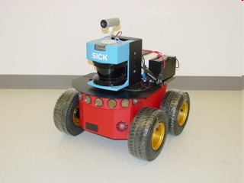
Applications of Particle Filtering in Robotics
Simultaneous Localization and Mapping (SLAM)
Observations: laser rangefinder
State variables: position, walls

Slide 50
Simultaneous Localization and Mapping (SLAM)
Mobile robots
Odometry
Locally accurate
Drifts significantly over time
Vision/ladar/sonar
Inaccurate locally
Global reference frame
Combine the two
State: (robot pose, map)
Observations: (sensor input)

Slide 51
General problem
x_{t} ~ Bel(x_{t}) (arbitrary p.d.f.)
x_{t+1} = f(x_{t},u,ε_{p})
z_{t+1} = g(x_{t+1},ε_{o})
ε_{p} ~ arbitrary p.d.f., ε_{o} ~ arbitrary p.d.f.
Process noise
Observation noise

Slide 52
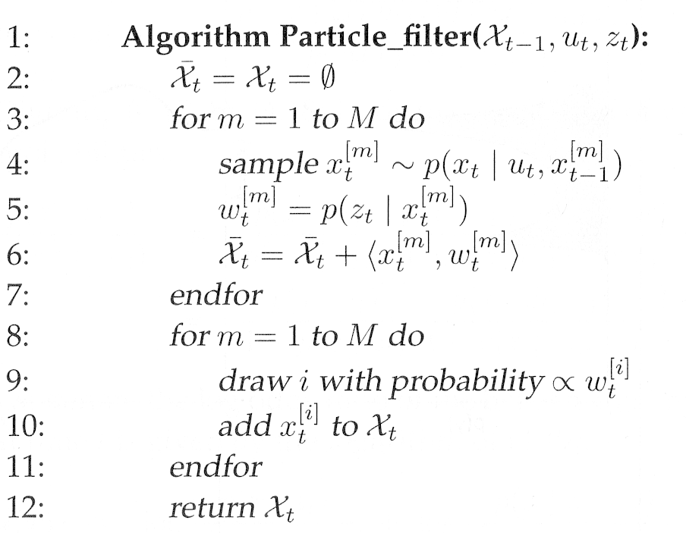
Sampling Importance Resampling (SIR) variant
Predict
Update
Resample

Slide 53
Advanced Filtering Topics
Mixing exact and approximate representations (e.g., mixture models)
Multiple hypothesis tracking (assignment problem)
Model calibration
Scaling up (e.g., 3D SLAM, huge maps)

Slide 54
Next Time
Putting it together: intelligent agents
Read R&N 2

